Slide 1
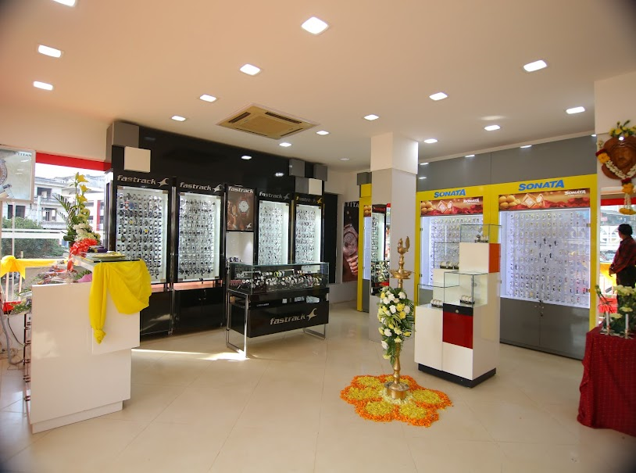
WATCH WORLD
Client: Watch World
Project By: Sudeep Pauskar
And
Ashmith K

Slide 2


Slide 3
1.Project Proposal
1.1 Title of the project:
Watch world
1.2 Introduction:
Watch world is a project about different types of watches under a single roof. Here admin manages all the user activities. The shops can add different types of time pieces such as watches , clocks , etc. Here the users can check for different types of time pieces according to their interest. Users can also purchase the watches, clocks as per their liking. Users can also sell their time pieces to the Watch world.

Slide 4
1.3 Objectives of the project:
I. The main objective of the Watch world is to provide different types of time pieces under one platform.
II. The Watch world can add their products.
III. The user can purchase or sell a time piece to the Watch world.
IV. The admin can keep track of all user activities.
1.4 Innovative idea behind the project:
In order to make the users life simpler we decided to create this platform which will allow the users to buy and sell different types of time pieces under one roof.
1.5 Project Category:
Web-Based Application Using RDBMS.

Slide 5
1.6 Languages to be used:
I. Front-end: Html, CSS, JavaScript
II. Back-end: MySQL, PHP
1.7 Hardware Interface:
I. Processors: Intel Pentium dual-core or above
II. RAM: 2 GB and above
III. Hard disk utilization: 5GB and above
IV. Input Devices: Mouse, Keyboard
1.8 Software Interface:
I. Browser: Internet Explorer, Google Chrome, Mozilla Firefox
II. Server: Apache
III. IDE: Visual Studio Code

Slide 6
1.9 Module Description:
Admin:
I. Login: Admin will enter the website using the username and password.
II. Manage Users: In this module, the admin can approve/reject the registered users.
III. Upload Blogs: Here admin can add watch blogs related to rules of buying and selling watches.
IV. Manage Payment: The admin can keep track of all payments.
V. Manage Report: The admin can manage monthly reports of sales made by the particular shop.
VI. Manage Shops: In this module, the admin can approve/reject the registered shops.

Slide 7
Shops:
I. Registration: The shops can register by giving their basic details.
II. Login: The shops can log in using his/her username and password.
III. Manage Profile: The shops can manage the shop details.
IV. Manage Products: The shops can add the watches. Here they can delete and update the product details.
V. Manage orders: In this module, the shop can see the order details
VI. View Feedback: The shops can view the feedback given by their customer.
VII. Manage Services: The shops can add and remove the services.
VIII. Rental: The shops can keep time pieces for rent.

Slide 8
Users:
I. Registration: The user can register by giving his/her basic details.
II. Login: The user can log in using his/her username and password.
III. Manage Profile: The users can manage personal details.
IV. View Watches: The user can view the watches added by the shops.
V. Order Products: The user can order different watches based on the watch category.
VI. Send Feedback: The user can send feedback to the particular shop.
VII. Request services: The users can request for the services that are available.
VIII. Rental: The users rent the available time pieces.

Slide 9
1.10: Limitations:
I. We act just as the medium thus for further enquiries of the product one has to contact the specific shop from where they purchased the watch.
1.11: Future Scope:
I. In future we’ll convert it into a mobile application.
II. We will be making it more user friendly(GUI).

